Slide 1



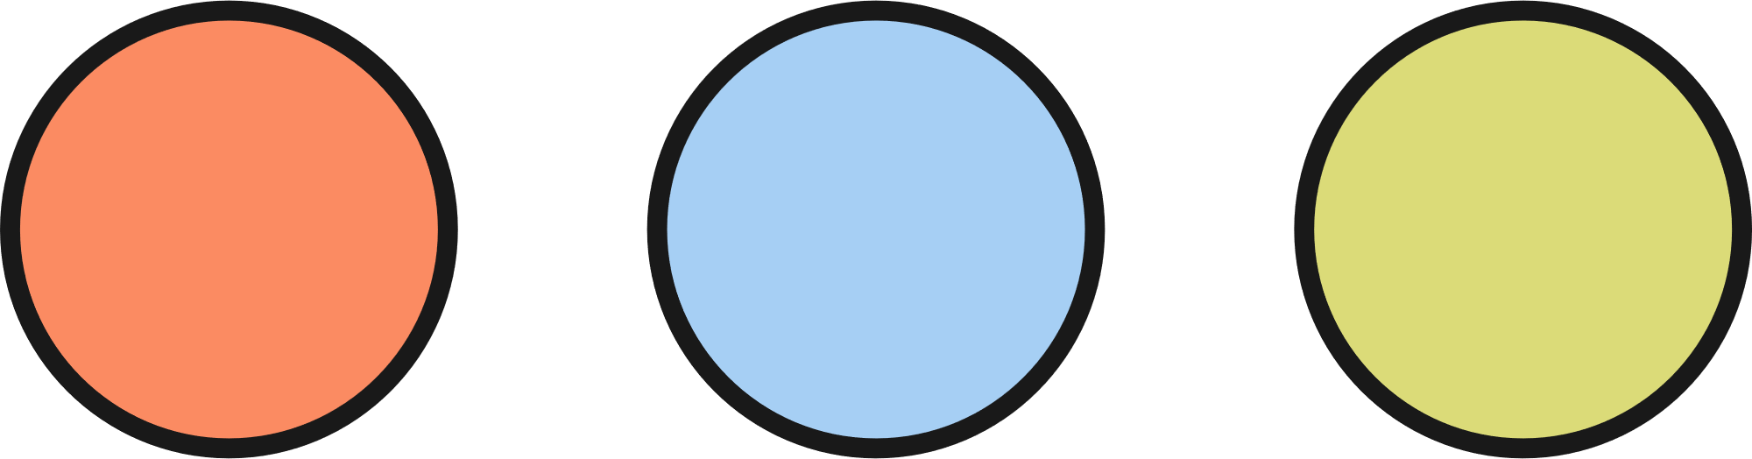

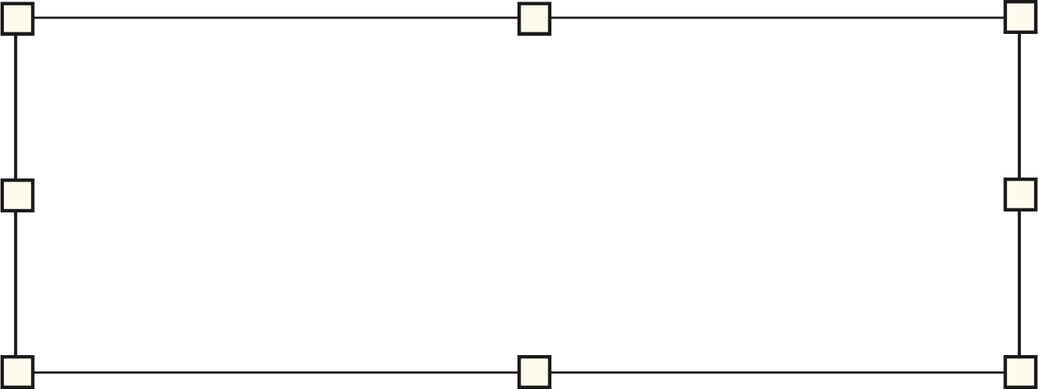
DARSH JAIN |  | 23.05.24
WEB DEVELOPMENT
FRAMEWORKS
What is a framework ?
How to choose a framework for your project ?
DIFFERENT FRAMEWORKS AND THEIR FEATURES

Slide 2


Index
What is a framework?
Basic Terminology
Frameworks
Summary
End

Slide 3


WHAT IS A FRAMEWORK ?
A framework provides a broader structure and foundation for building an entire application. It dictates the overall architecture and workflow of the application.
It’s different from a library which provides specific functionalities and tools for developers to integrate into their applications.
Notes:
Framework: House Blueprint. Provides overall structure of the app.
Library: Premade furniture for the house. Provides functionality used in app.

Slide 4
Important Terms
Model-View-Controller (MVC)
Object Relational Mapper (ORM)
Controller
Using OOP to access
Model
Relational Database
View
Notes:
MVC -
Model is the database.
View is the UI seen by the user.
Controller takes user input and updates the model and view accordingly.
ORM - Using objects in code to access database instead of queries. Attributes of our object are the columns of our database.

Slide 5
JAVA - SPRING
Aspect-Oriented Programming (AOP)
Inversion of Control (IoC)
Spring MVC
Spring Boot
Spring Data
Spring Security
Spring Cloud
Notes:
Used for enterprise grade application development requiring scalability, maintainability and security.
IoC - A container that puts the dependencies at the appropriate places (dependency injection). So we don't have to deal with it ourselves.
AOP - Separates cross-cutting concerns (eg. logging, and other small tasks) from business logic. We can make an aspect and set rules when it should run. Improves productivity (focus on main logic).
MVC - Model View Control architecture to make web apps.
Boot - Foundation to build web apps. We use additional Spring Libraries with it.
Data - Offers common API to ease accessing data from various sources. (SQL or NoSQL, through ORMs (for SQL)).
Security - Built in security in the framework (eg. Authentication).
Cloud - Use for making cloud based apps.

Slide 6
C# - .NET
Windows Communication Foundation (WCF)
Entity
Framework
.NET Core and .NET 5/6
ASP.NET
Common Language Runtime (CLR)
Windows Presentation Foundation (WPF)
Framework Class Library (FCL)
Notes:
Used to develop enterprise grade applications especially those with heavy reliance on Microsoft products.
Entity Framework - ORM
ASP.NET - Develop Web Apps
WCF - Service Oriented Apps and Inter Thread Comms (Multi threading)
WPF - Make windows apps
CLR - Manages execution of .NET applications.
FCL - Comprehensive set of libraries included with the framework.

Slide 7
RUBY - RUBY ON RAILS
RESTful Application Design
MVC Architecture
Convention Over Configuration
ActiveRecord
Automated Testing
Scaffolding
Notes:
Used for rapid development of projects, suitable for MVP (Minimum Viable Product) development.
MVC - Model View Controller
ActiveRecord - ORM Object-Relational Mapper
CoC - Build apps quickly by assuming the best method to implement certain functionalities. Less decision taken by Developer.
REST - Encourages RESTful design of web apps. Making it easier to develop APIs.
Automated Testing - Built in testing tools for test-driven development.
Scaffolding - Boilerplate code for CRUD ops. Speeding up development.

Slide 8
PHP -LARAVEL
Blade Templating Engine
Artisan Command Line Interface (CLI)
Routing,
Middleware,
Security
Eloquent ORM
Task Scheduling
Testing
Notes:
Has an elegant syntax and is used to develop apps such as Content Management Systems (CMS).
Eloquent - ORM Object-Relational Mapper
BTE - Templating Engine to create dynamic HTML content.
Artisan CLI - CLI with helpful commands to automate repetitive tasks.
Routing - Manage URL endpoints
Middleware - Preprocess request data before usage. (params, queries, etc.)
Security - Built in security features in framework (like Authentication, Authorization and protection against CSRF - Cross Site Request Forgery and SQL injections).
Task scheduling - Ability to schedule commands using artisan cli at specific time, frequency, etc.
Testing - Built in testing suite to ensure application quality.

Slide 9
PYTHON -DJANGO
Templating Engine
Routing,
Security
ORM
Admin Interface
Scalability
REST framework
Notes:
Used to develop data-driven apps especially ones associated with Data Science or Machine Learning.
ORM - Object-Relational Mapping feature
Templating Engine - Generate dynamic html content.
Admin Int- Automatically generate admin interfaces for managing app data.
Routing - Defining URL endpoints
Security - Built in security protection against SQL injection, Cross Site Scripting (XSS), Cross Site Request Forgery (CSRF).
Scalability - Scales well with high traffic applications and supports caching and load balancing.
REST - Ability to make REST APIs.

Slide 10
JS - EXPRESS.JS
Templating Engine
Asynchronous and Non-Blocking
Serve Static
Files
Routing
Middleware
REST framework
Notes:
It is a lightweight framework used to develop real-time and event driven apps such as collaborative whiteboards
and APIs.
Async and Non blocking I/O -
Most languages first send a request to a service and wait (i.e. pause execution) until the response has come back.
This poses serious performance issues in case the server or device is unavailable or slow.
But incase of Node.js, JavaScript sends the request and doesn't pause execution of program (i.e. non blocking). It is event driven and so when it detects the event of response by the service (receives the response). It then pauses the current process and executes the process related to the response.
This allow for multiple real-time connections and event driven activity on those without performance loss.

Slide 11

FRONTEND FRAMEWORKS
MOST USED
FRONTEND FRAMEWORKS
Vue.js
Svelte
ReactJS
AngularJS
Notes:
Frontend frameworks are used to make intricate UIs efficiently.
The most used technologies are:
1. ReactJS
2. Angular
3. Vue.js
4. jQuery
5. Svelte
Here I won't be considering jQuery as its just shortening the Vanilla JavaScript code.

Slide 12
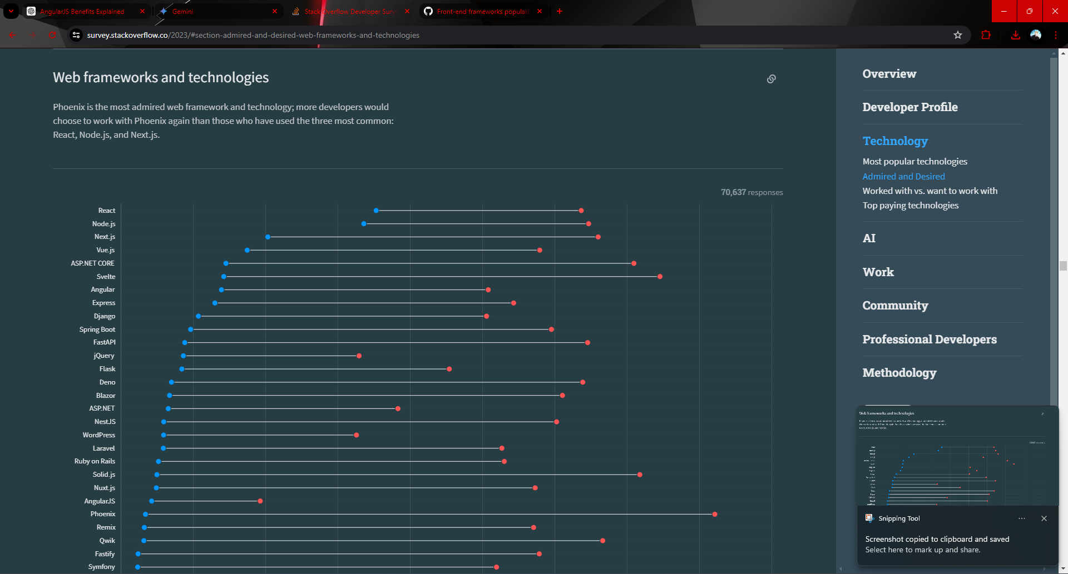
Notes:
This is the 2023 Developer Survey by Stack Overflow. As we can see the most used technology for frontend is React followed by Vue, Svelte, Angular.

Slide 13
React | Angular | Vue | Svelte
Component-Based Architecture | Complete Framework | Progressive Framework | Compile-Time Framework
Virtual DOM | Two way data binding | Two way data binding | No Virtual DOM
Ecosystem | Dependency Injection | Single-File Components | Simplicity
Flexibility | TypeScript | Flexibility | Reactive Programming & Small Bundle Sizes
Notes:
Features of these technologies, starting with the most popular one:
React: Used to develop highly performant complex UIs and interactive apps.
Component-Based Architecture: Divide the web page into smaller, reusable pieces called components. This increases code maintainability.
Virtual-DOM: Its an abstraction layer between the real DOM and the code.
The changes in the code are first made to the virtual DOM. React then calculates differences between virtual DOM and real DOM and applies difference only to the Real DOM. This significantly increases performance.
Ecosystem: React has a rich ecosystem and support by Meta.
Flexibility: React can be used with third party libraries such as Redux (state management) and react-router-dom (SPAs).
Angular: Used to build robust, large scale enterprise apps and Progressive Web Apps (PWAs - Push Notifications, Background Sync (ex. schedule mails) when offline ).
Complete Framework: Angular in itself is a complete framework with built in routing, HTTPClient and other libraries.
Two Way Data Binding: When the UI changes the data in code also updates accordingly and vice versa. This makes sure that UI and code are in sync.
Dependency Injection: Promotes loose coupling by injecting the instance of a dependency at need where required by the container. Like Inversion of Control. This improves testability.
TypeScript: Type safety ensures a scalable app.
Vue: Used to build relatively smaller scale apps, SPAs.
Progressive Framework: Can be integrated with existing project progressively and the developer is not forced to use a rigid structure.
Two Way Data Binding: Just like Angular,
in Vue, when the data in either UI or code changes the other updates itself to be in sync.
Single-File Components: All the HTML, CSS, and JavaScript is encapsulated within a single file. This introduces modularity and increases code maintainability.
Flexibility: Can be used alongside other libraries and frameworks like React and Angular.
Svelte: Used to build highly performant and light weight web apps.
Compile-Time Framework: It compiles the code to highly efficient JavaScript during build time. This results in performance improvements during runtime.
No Virtual DOM: Not maintaining a virtual DOM is faster when we consider simple UIs. The pre-compiled JavaScript also contributes to faster DOM rendering.
Simplicity: Simple and concise syntax improves code readability and reduces development time.
Reactive Programming: We can make reactive statements in Svelte. These can include assignments, calculations and function calls.
Upon running a reactive statement, Svelte will track all the variables it depends on. If Svelte detects any changes in those variables, it will re-run all the reactive statements concerned with that variable and update the UI accordingly.
Small Bundle Sizes: Pre-Compiled code results in smaller and lighter bundle sizes.

Slide 14
CONCLUSION
Ruby on Rails
Rapid Development of Web Applications, especially Startups and MVPs.
Spring
Well suited for enterprise-scale applications requiring scalability, maintainability and security.
.NET
Well suited for apps with heavy
reliance on windows ecosystem
and services.
Laravel
Great for developing web apps such as CMS with elegant syntax.
Django
Suitable for building data-driven web apps especially machine learning and data science projects.
Express.js
Realtime Event Driven applications like collaborative whiteboards. APIs and microservices.
Notes:
In conclusion, each framework has its strengths. None is perfect. We now know more about enterprise grade development and good coding practices.

Slide 15
CONCLUSION
React.js
Excellent for building complex interactive user interfaces and dynamic web applications.
Angular
Suitable for building large-scale enterprise applications, SPAs, PWAs with robust features and extensive tooling.
Vue.js
Used for building small scale, SPAs and dynamic web applications.
Svelte
Perfect for building highly performant and lightweight web applications with a focus on minimalism and efficiency.

Slide 16
Thank you

